Slide 1
Baby Names by Ethnicity
NYC Open Data Libraries- pandas,numpy,matplot,seaborn,csv
Motivation- Looking for something lighthearted- not very critical information;less use of numbers,
and I enjoyed the fact that the data was clean- there were no missing or Nan values.
Initially I wanted to go with another dataset but I managed to confuse myself and started all over.

Slide 2
Most Popular Names by Ethnicity
Asian & Pacific Islander
Black Non Hispanic
Hispanic
White Non Hispanic
Zoey, Zoya
Zuri, Zyaire
Zuri
Zoey

Slide 3
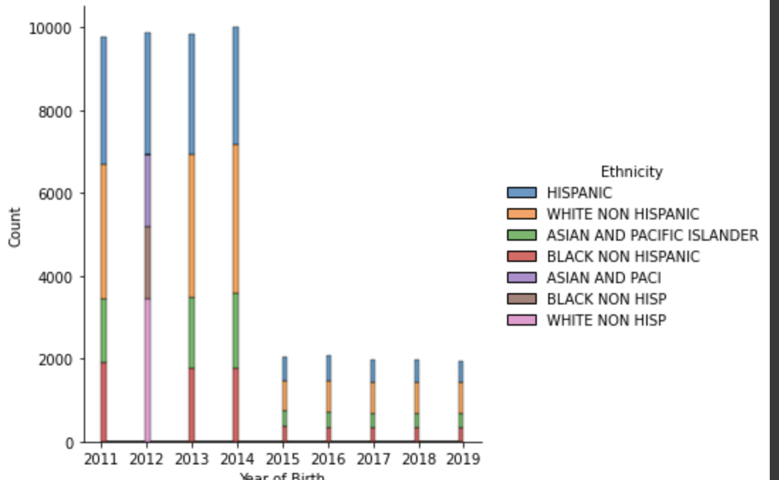

Slide 4
Conclusion
Interesting to me how the most popular names between 2011-2019 are Zoey, Zuri, Zoya
If you need baby name ideas; you should look up this data, lol

